Slide 1
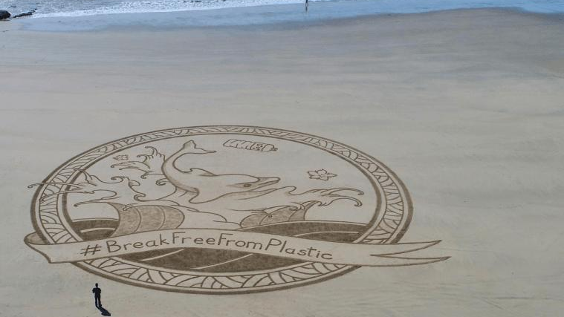
Delphine Lévi Alvarès
Coordinator
Break Free From Plastic Europe
Rethink Plastic alliance
November 20

Slide 2
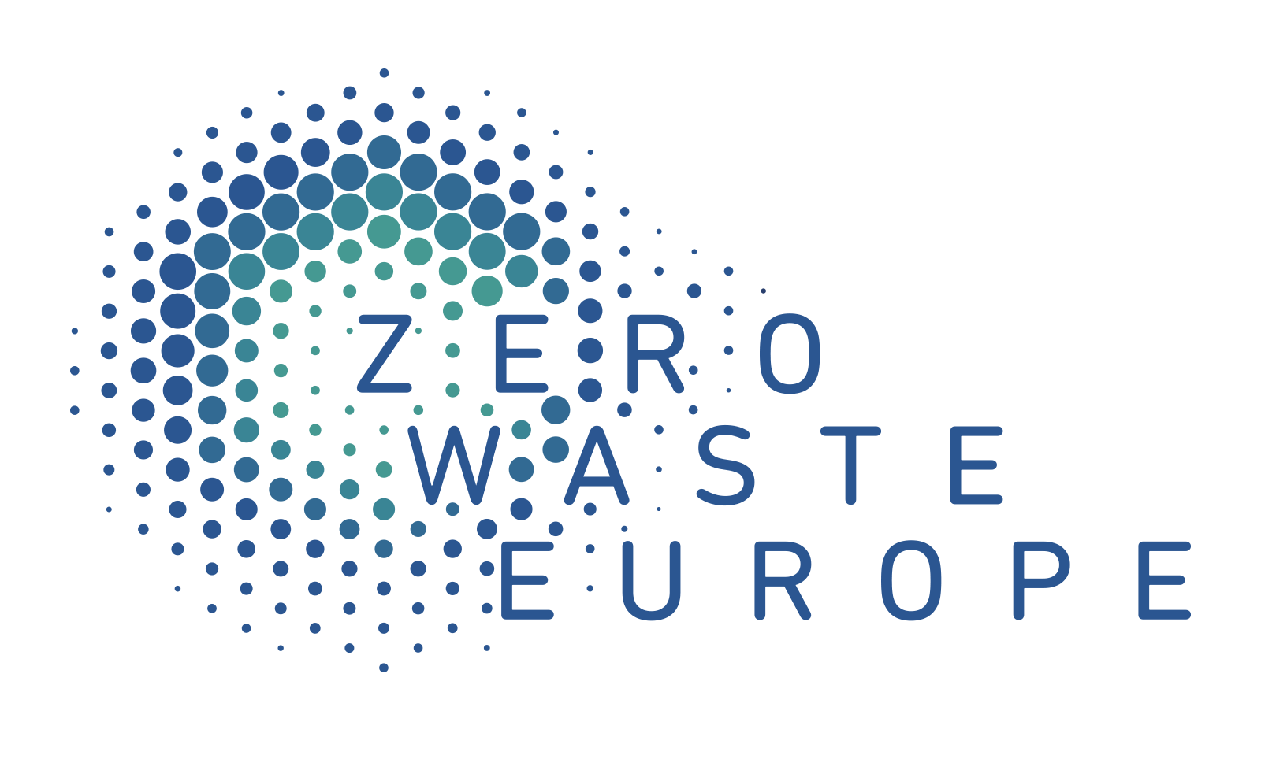
We are…
10 leading European NGOs representing thousands of active groups, supporters and citizens in every EU Member State, and bringing together policy and technical expertise all along the plastic value chain
The EU policy arm of Break Free From Plastic, the global movement envisioning a future free from plastic pollution, representing more than 1400 NGOs from across the world

Slide 3
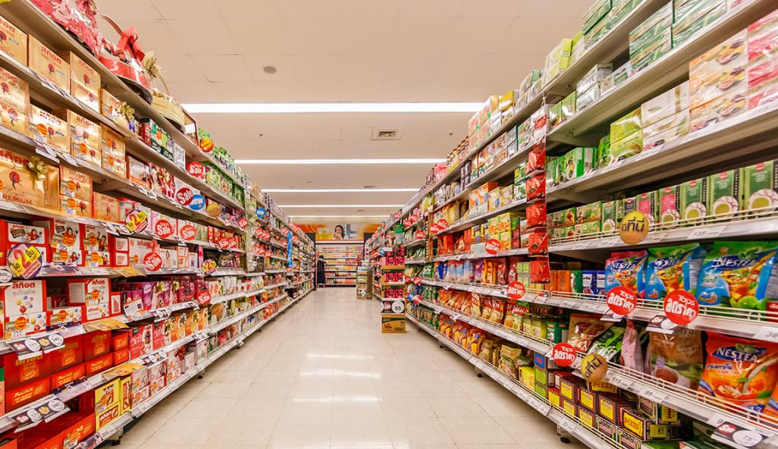
Where EPR has not helped circular economy
Single-use over reusable
Lightweighting
Recycling over reduction

Slide 4
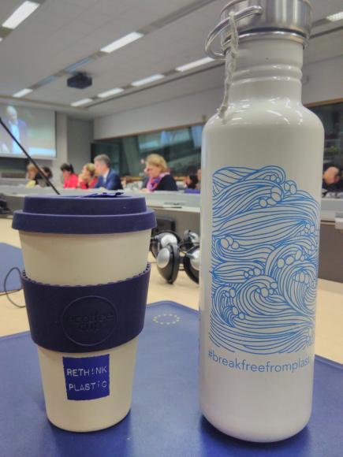
Where EPR can help circular economy
Implementation of the waste hierarchy
Modulated fees according to ecodesign criteria
Dialogue between the actors of the sector to phase out toxics and build the trust in the recycled plastic market
Coverage of the cleanup and waste management costs

Slide 5
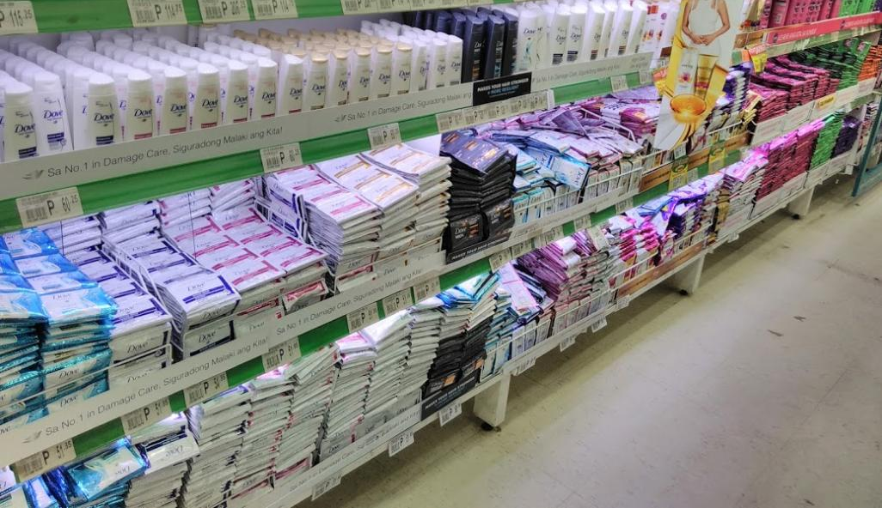
And beyond Europe?
End double standards
Take responsibility for the plastic pollution
Include the informal sector in the discussion towards new EPR schemes

Slide 6
Delphine Lévi Alvarès
Coordinator
Break Free From Plastic Europe
Rethink Plastic alliance
delphine@zerowasteeurope.eu
delphine@rethinkplasticalliance.eu

