Slide 1
Marine Litter: “EPR as driver of the circularity of packaging“
22 November 2018 | European Parliament, Brussels

Slide 2
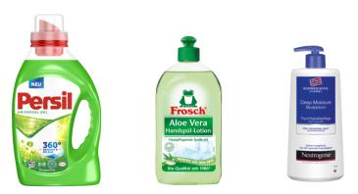
Marine Litter: „EPR as a driver of the circularity of packaging“
Extended Producer Responsibility (EPR) is a key lever for a circular economy
Gives (plastic) waste a value
Encourages eco-design
Reduces waste and littering
Promotes dialogue and cooperation
100% PP-Recyclate
100% PET-Recyclate

Slide 3
Marine Litter: „EPR as a driver of the circularity of packaging“
EPR will not work in isolation – Tackling marine littering requires joint action
Sharing knowledge – developing solutions
Industry, municipalities, NGOs and consumers working hand in hand

Slide 4
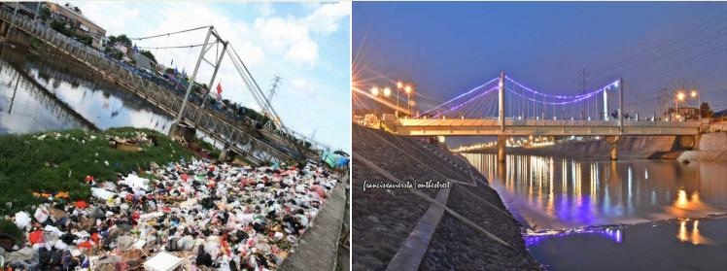
Marine Litter: „EPR as a driver of the circularity of packaging“
Providing solutions at a global scale – based on European EPR experiences and knowledge
Source: Ogroseno AH
West Canal River – West Jakarta

