Slide 1
Key environmental challenges & the role of the Sustainable Development Goals
European Parliament
19 November 2019
Dirk Carrez
Executive Director
Biobased Industries Consortium

Slide 2
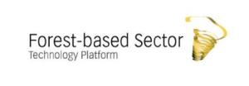
Members of the EUBA

Slide 3
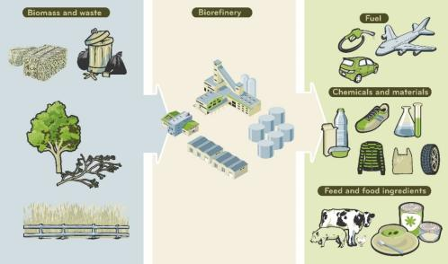
Bioeconomy and SDGs
The bioeconomy has a key role to play in the transition to a more circular, renewable and resource efficient society.
Only consistent, long‐term and stable policies, especially for the areas of energy, environment, climate, innovation, forestry and agriculture, will attract the necessary investments and foster the full potential of the bioeconomy.
EUBA sees the bio-economy contributing in particular to SDG 2, 7, 8, 9, 12, 13, 15, 17.

Slide 4
Two examples
End hunger, achieve food security and improved nutrition and promote sustainable agriculture
EU agriculture is playing a vital role in enabling food security whilst providing sustainable and locally produced biomass. This includes the valorisation of by‐ and co‐products as well as residues that would otherwise be considered as waste. This is complemented by both working with biorefineries and through the development of new cross‐sectoral bio‐based value chains. Example by EUBA The production of valuable co‐products in the biofuel process, notably for the livestock sector, allows the EU to decrease its protein deficit and thereby increases the availability of agricultural products and land. Other examples illustrated by BBI JU projects: PLENITUDE, FARMYNG, …
Take urgent action to combat climate change and its impact
The bioeconomy contributes to climate change mitigation by reducing dependency on fossil‐based materials and energy. Renewable raw materials reduce greenhouse gas emissions by sequestering CO2 in the plants during their growth. Biobased products store carbon during their life cycle and are then either recycled several times or converted into bio‐energy. Example by EUBA In London, a timber frame of a 10-story carbon neutral apartment complex made of cross-laminated timber locks in 2,600 tons of carbon. In addition, the frame has 50% less embodied CO2 - the amount of energy required to produce and form a material - than a traditional concrete frame.

Slide 5
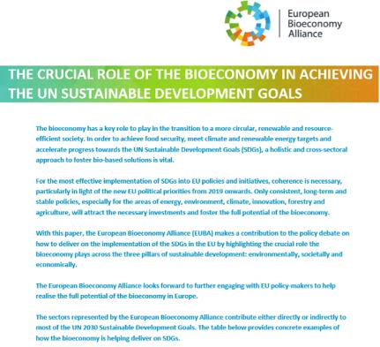
More examples (for information)
EUBA published concrete examples of how the bioeconomy is helping to deliver on SDGs.

Slide 6
Thank you for your attention!
Dirk Carrez@biconsortium.eu
www.bioeconomyalliance.eu
hello@bioeconomyalliance.eu
‎@EUBioeconomy

