Slide 1
European Parliament, 19 November 2019
Key environmental challenges & the role of the SDGs
Veronika Juch Liaison officer with the European Parliament, Food and Agriculture Organization of the United Nations (FAO)

Slide 2
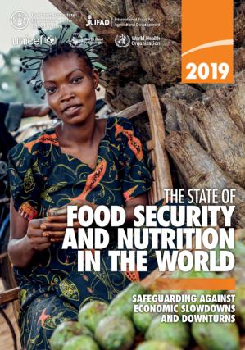
t
The State of Food Security and Nutrition in the World
(SOFI)
“Safeguarding against economic slowdowns and downturns”
15 July 2019
More than 820 million people in the world do not have enough to eat
New indicator Food Insecurity Experience Scale (FIES): 2 billion people in the world experience moderate or severe food insecurity
Global level of the prevalence of undernourishment has stabilized
1/7 live births was characterized by low birthweight
Overweight and obesity continues to rise in all regions
Economic slowdowns or downturns disproportionally undermine food security and nutrition where inequalities are greater
Integrating food security and nutrition concerns into poverty reduction efforts is needed to ensure structural transformation
Read more: https://bit.ly/2LVnHsW

Slide 3
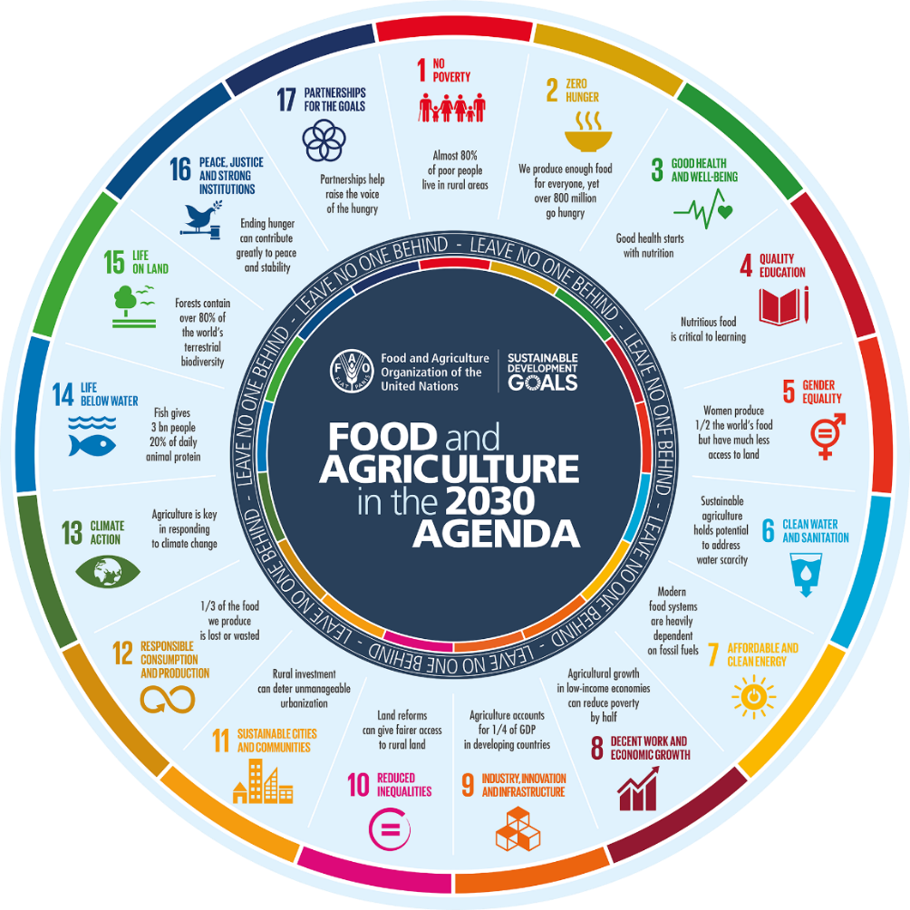

Slide 4
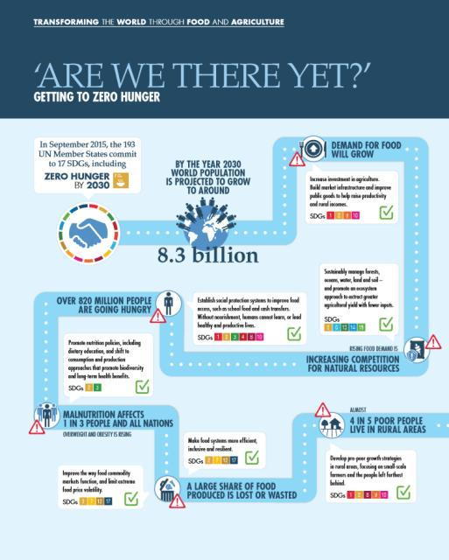
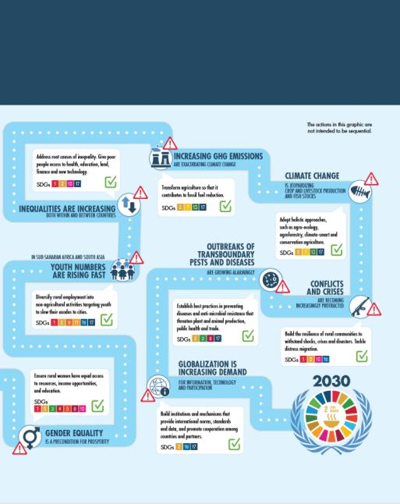

Slide 5
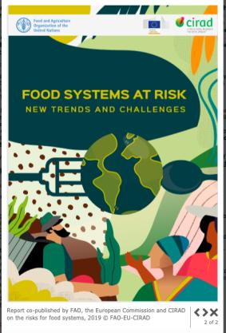
t
Transforming the World through Food and Agriculture
Read more: https://bit.ly/2Oe116L
Read more: https://bit.ly/2Ohk9k8

