Slide 1
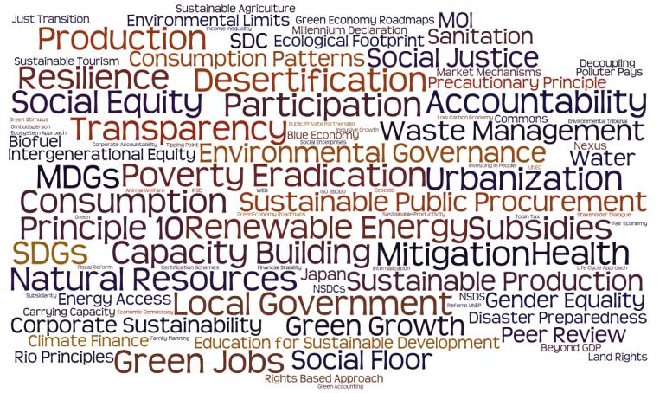
Notes:
Climate change marginalised but overarching indicator

Slide 2
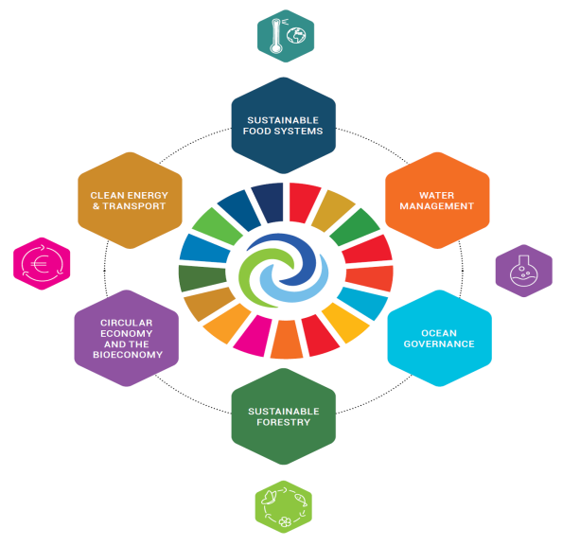
INTERGROUP MANIFESTO

Slide 3
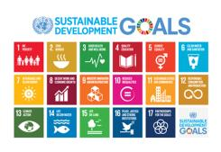
Notes:
- What must be done for biodiversity conservation to achieve the SDGs?
- What are the synergies and trade-offs (intact nature delivering ecosystem goods and services, biodiversity conservation and delivery of SDGs)?
In due course we need to think about the process that will allow the SDGs to be updated post 2020
Sustainable development depends on biodiversity
Aichi and SDG linkages are not explicitly / only weakly referenced in draft COP decision (SBSTTA/REC/XX/I)
As a new post-2020 biodiversity framework is developed, the 2030 Agenda as an opportunity.
The SDGs whose targets are built on ATs should ultimately be updated, strengthened and meaningfully taken up in the SDG process (beyond SDG14 & 15)

Slide 4
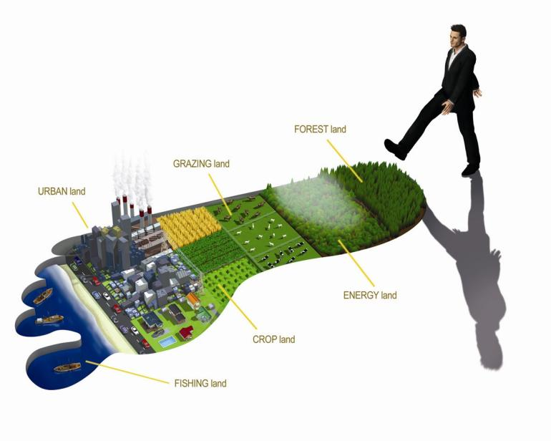
Our Ecological Footprint
CARBON footprint
FISHING grounds
Notes:
How do we know? By using Ecological Footprint accounting
The Ecological Footprint is the area of land and water it takes for a human population to generate the renewable resources they consume and degrade the waste it produces in a given technological context. In other words, it measures the "quantity of nature" that we use, and compares it with how much we have (biocapacity). This accounting supports decision makers when it comes to making difficult choices, managing conflicts of objectives and placing themselves in an optimal situation for the future. The accounts can be applied to the global, country, region, individual or product.
Cropland: Cropland is the most bioproductive of all the land-use types and consists of areas used to produce food and fiber for human consumption, feed for livestock, oil crops, and rubber. Due to lack of globally consistent data sets, current cropland Footprint calculations do not yet take into account the extent to which farming techniques or unsustainable agricultural practices may cause long-term degradation of soil. The cropland Footprint includes crop products allocated to livestock and aquaculture feed mixes, and those used for fibers and materials.
Forest land: The forest Footprint is calculated based on the amount of lumber, pulp, timber products, and fuel wood consumed by a country on a yearly basis.
Grazing land: Grazing land is used to raise livestock for meat, dairy, hide, and wool products. The grazing land Footprint is calculated by comparing the amount of livestock feed available in a country with the amount of feed required for all livestock in that year, with the remainder of feed demand assumed to come from grazing land.
Carbon Footprint: Carbon dioxide emissions from burning fossil fuels are currently the only waste product included in the National Footprint Accounts. The carbon Footprint includes embodied carbon in imported goods. The carbon Footprint component of the Ecological Footprint is calculated as the amount of forest land needed to absorb these carbon dioxide emissions. Currently, it is the largest portion of humanity’s Footprint.
Fishing grounds: The fishing grounds Footprint is calculated based on estimates of the maximum sustainable catch for a variety of fish species. These sustainable catch estimates are converted into an equivalent mass of primary production based on the various species’ trophic levels. This estimate of maximum harvestable primary production is then divided amongst the continental shelf areas of the world. Fish caught and used in aquaculture feed mixes are included.
Built-up land: The built-up land Footprint is calculated based on the area of land covered by human infrastructure — transportation, housing, industrial structures, and reservoirs for hydro­power. Built-up land may occupy what would previously have been cropland.

Slide 5
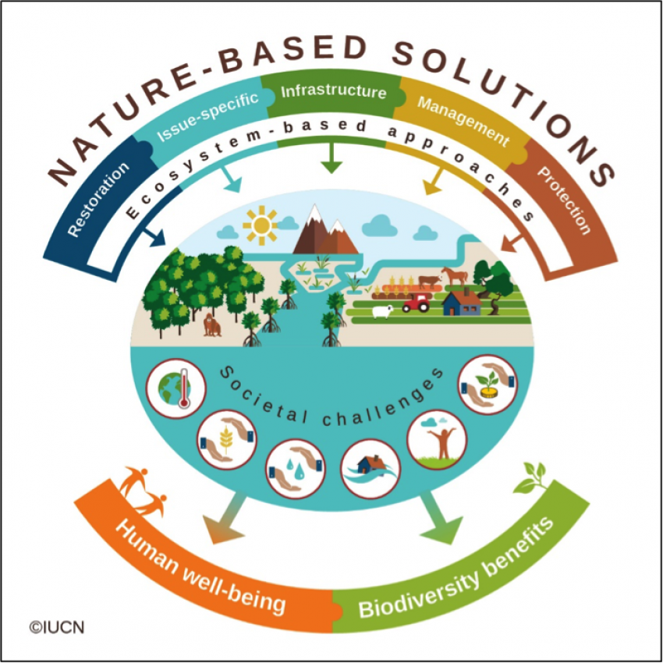
https://www.arkive.org/land-snail/orcula-fuchsi/image-G126167.html

